Slide 1
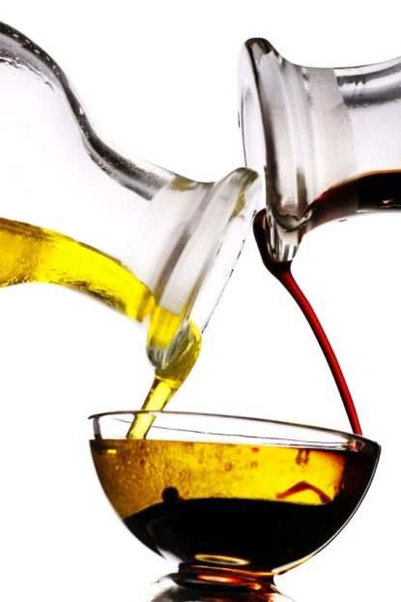
Density

Slide 2
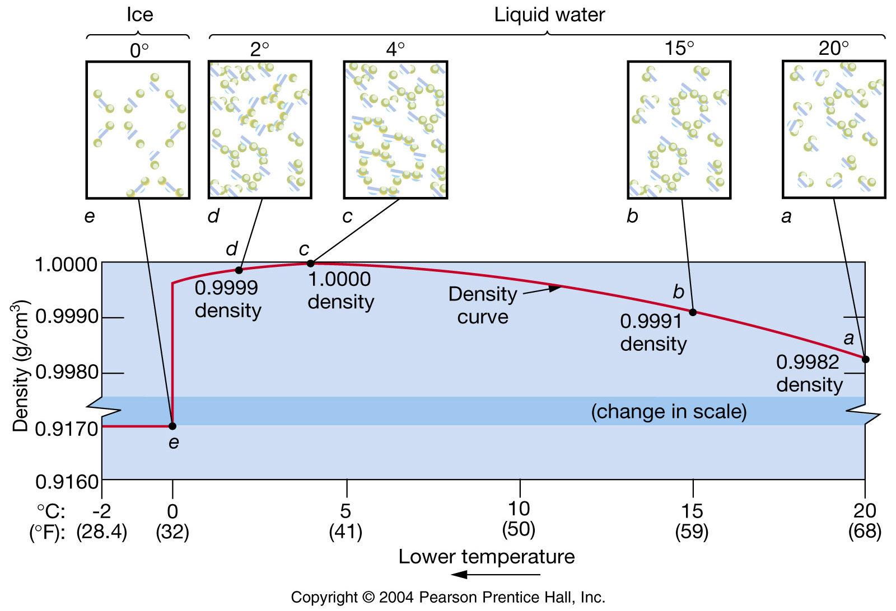
Notes:
Ice example show class

Slide 3
WHAT IS DENSITY?
Density (kg m⁻³) is dependent on temperature, salinity and pressure
If the objects are fluids, changes in density = horizontal layering; the fluids will arrange themselves such that the less dense fluid floats on top of the denser fluid. An example of this situation is oil floating on water.
The horizontal layering of fluids of different density is called stratification.
Pure water = 1000 kg m⁻³
Sea water = 1025 kg m⁻³
The density of sea water (ρ) depends on temperature T, salinity S and pressure p. This dependence is known as the Equation of State of Sea Water.
ρ = ρ ( Temp, Salinity, Pressure ) - 1000 kg m⁻³

Slide 4
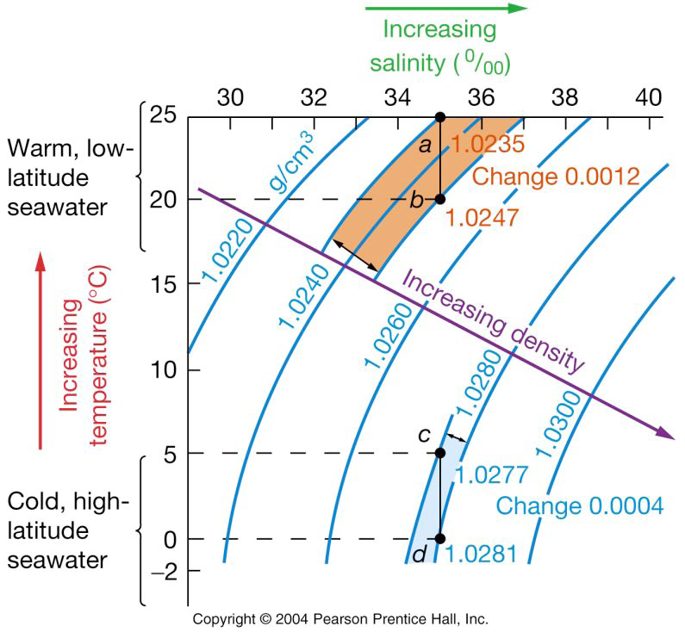

Slide 5
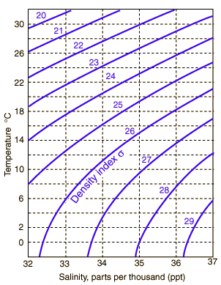
Lines of equal density known as isopycnals – al water lying on this line will have the SAME density
Inside Agulhas Current water is 24°C and 35.5 psu
Outside Agulhas Current water is 24°C and 35.2psu
WHICH IS HEAVIER?

Slide 6
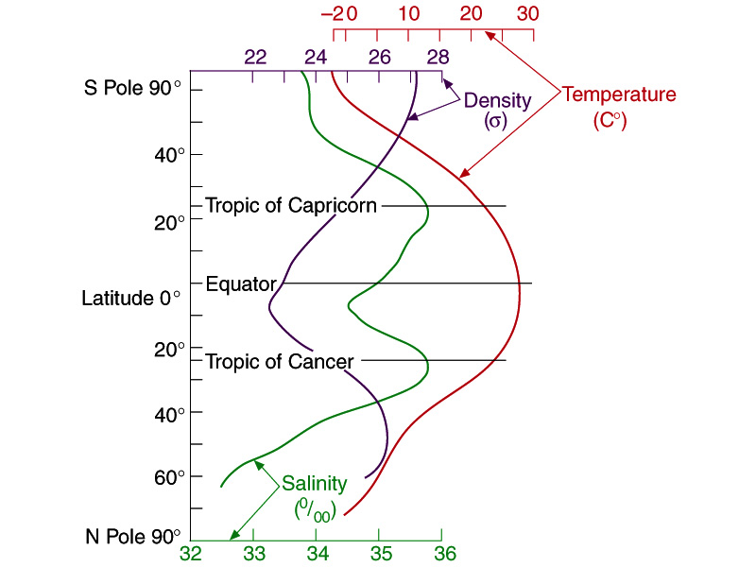
See the correlation between density and salinity

Slide 7
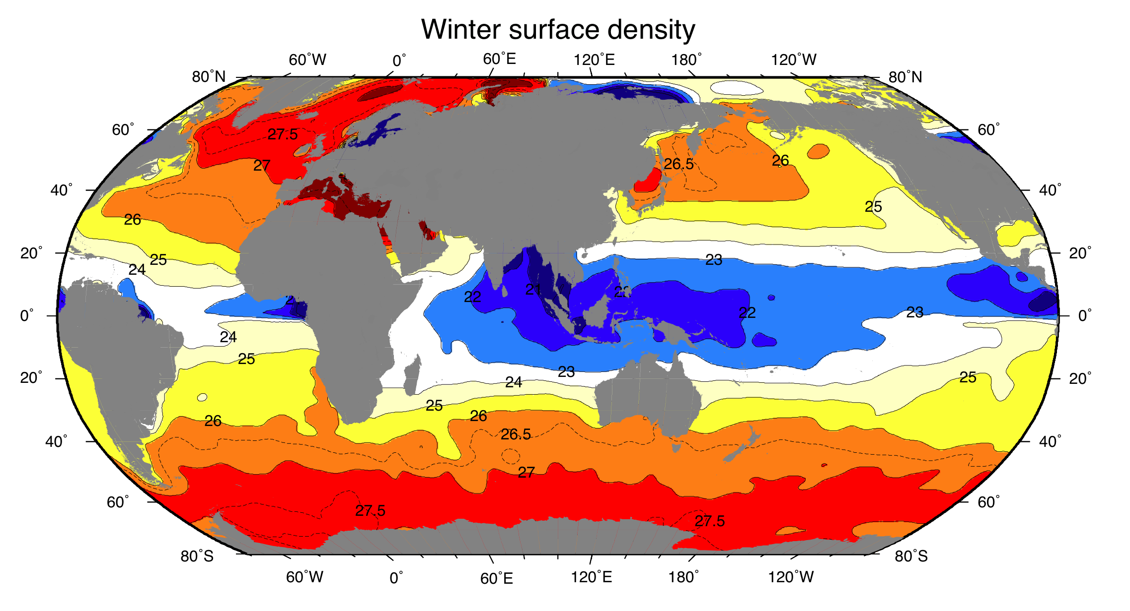
Warm tropical water is light
Cold antarctic water is heavy

Slide 8
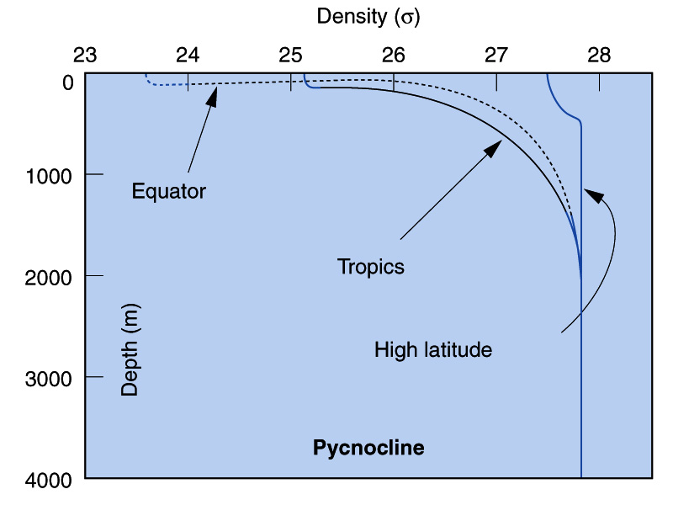
Density in the top 1000 m varies latitudinally

Slide 9
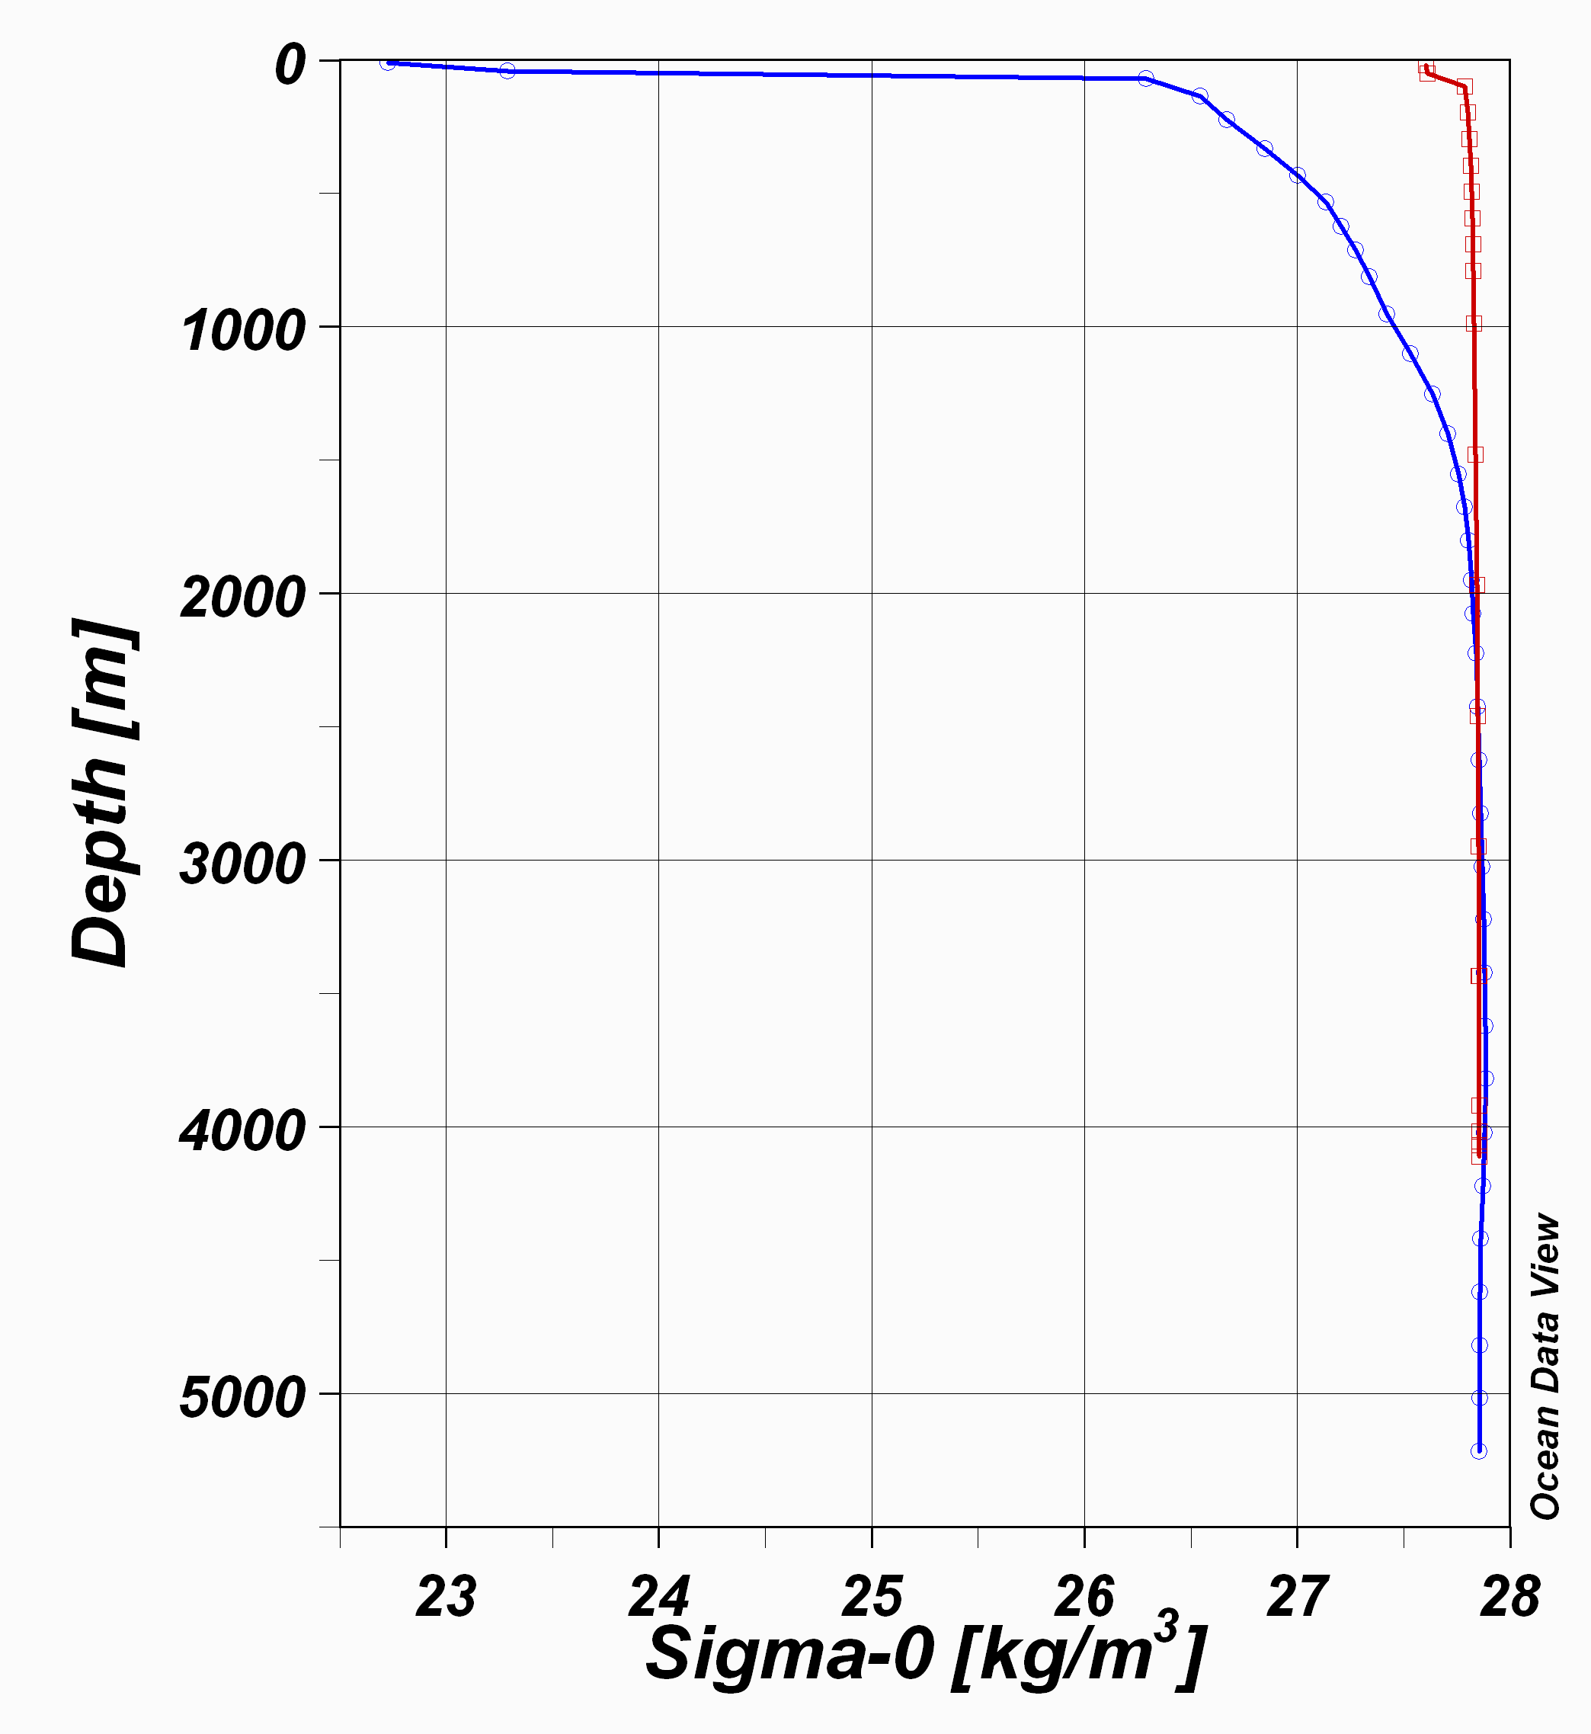
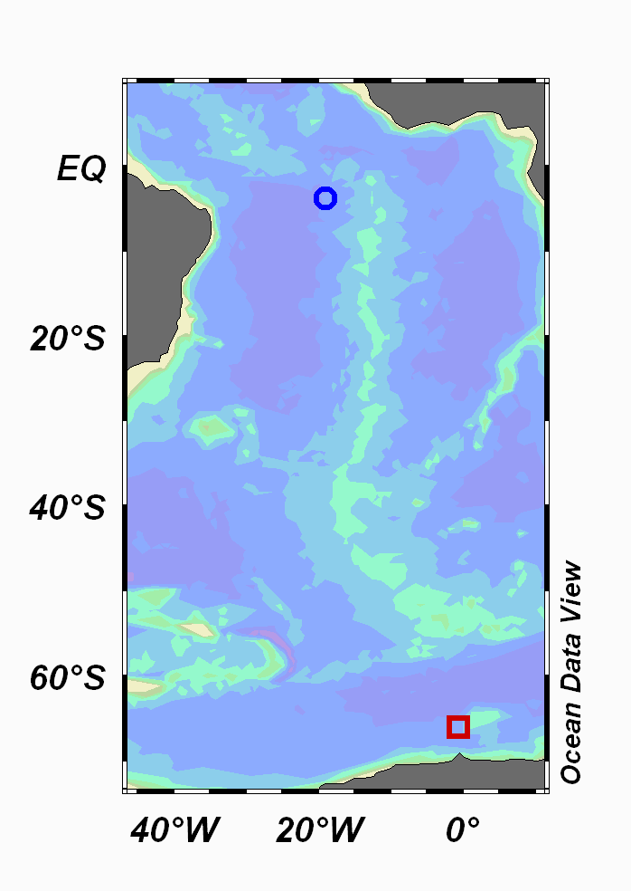
Cold dense surface water of the Antarctic

Slide 10
Warm low density surface water of the Equator

Slide 11
Note the difference in pycnocline!!

Slide 12
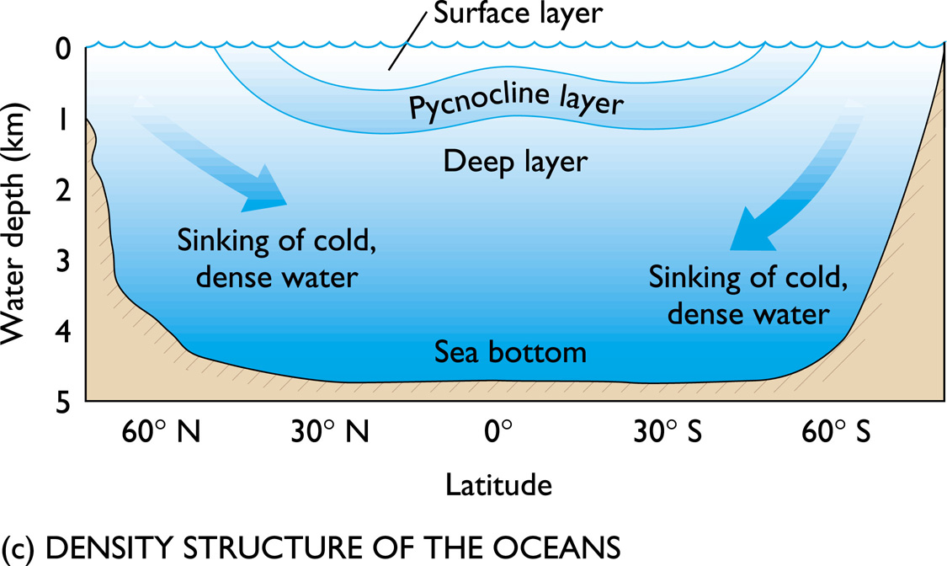

Slide 13
Salinity has it’s greatest influence on density in polar oceans where temperature has its smallest influence
Pycnocline, rapid change of density with depth
Thermocline, rapid change of temperature with depth
Halocline, rapid change of salinity with depth
Polar ocean is isothermal and isopycnal

Slide 14
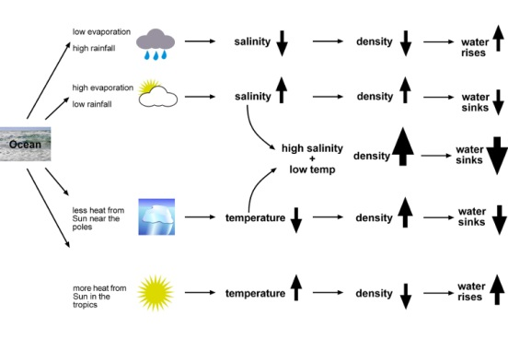

Slide 15
The water column in the ocean can be divided into the surface layer, pycnocline and deep layer.
The surface layer is ~1000m thick, comprises about 2% of the ocean volume and is the most variable part of the ocean because it is in contact with the atmosphere.
The surface layer is less dense because of lower salinity or higher temperature.
The pycnocline is transitional between the surface and deep layers and comprises 18% of the ocean basin.
In the low latitudes, the pycnocline coincides with the thermocline, but in the mid-latitudes it is the halocline.

Slide 16
The deep layer represents 80% of the ocean volume.
Water in the deep layer originates at the surface in high latitudes where it cools, becomes dense, sinks (convects) to the sea floor and flows outward (advects) across the ocean basin.

Slide 17
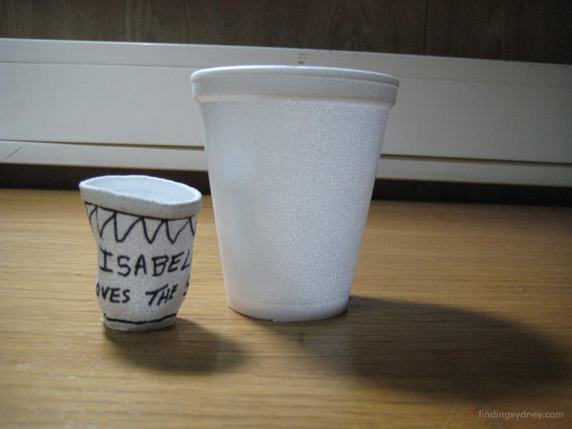
Ocean Pressure

Slide 18
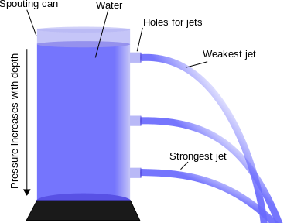
Water Pressure
Water exerts pressure because it is a fluid.
Water pressure increases with depth because of gravitational pull.

Slide 19
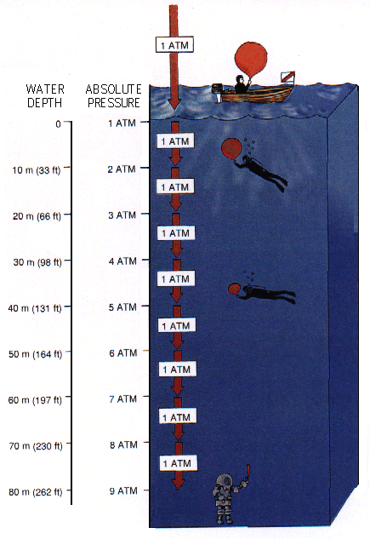
The pressure at a given depth depends on the mass of water lying above that depth.
Ocean pressure is usually measured in decibars. 1 dbar = 10⁴ Pascal.
1 ATM = 1 bar
So ..if the pressure change is 100 dbar, gravity g = 9.8 m/sec², and average density is 1025 kg/m³, then the depth change is 99.55 meter.
This is known as the
HYDROSTATIC EQUATION
We can then solve for the change in pressure for a given change in depth.
For:
Δz = 1 meter, density ρ ~1025 kg/m³, and g = 9.8 m/s², we get
Δp = - ρ g Δz = (1025 kg/m³)(9.8 m/s²)(1 m) =
10045 kg/(m s²) = 0.10045 bar = 1.0045 dbar

Slide 20
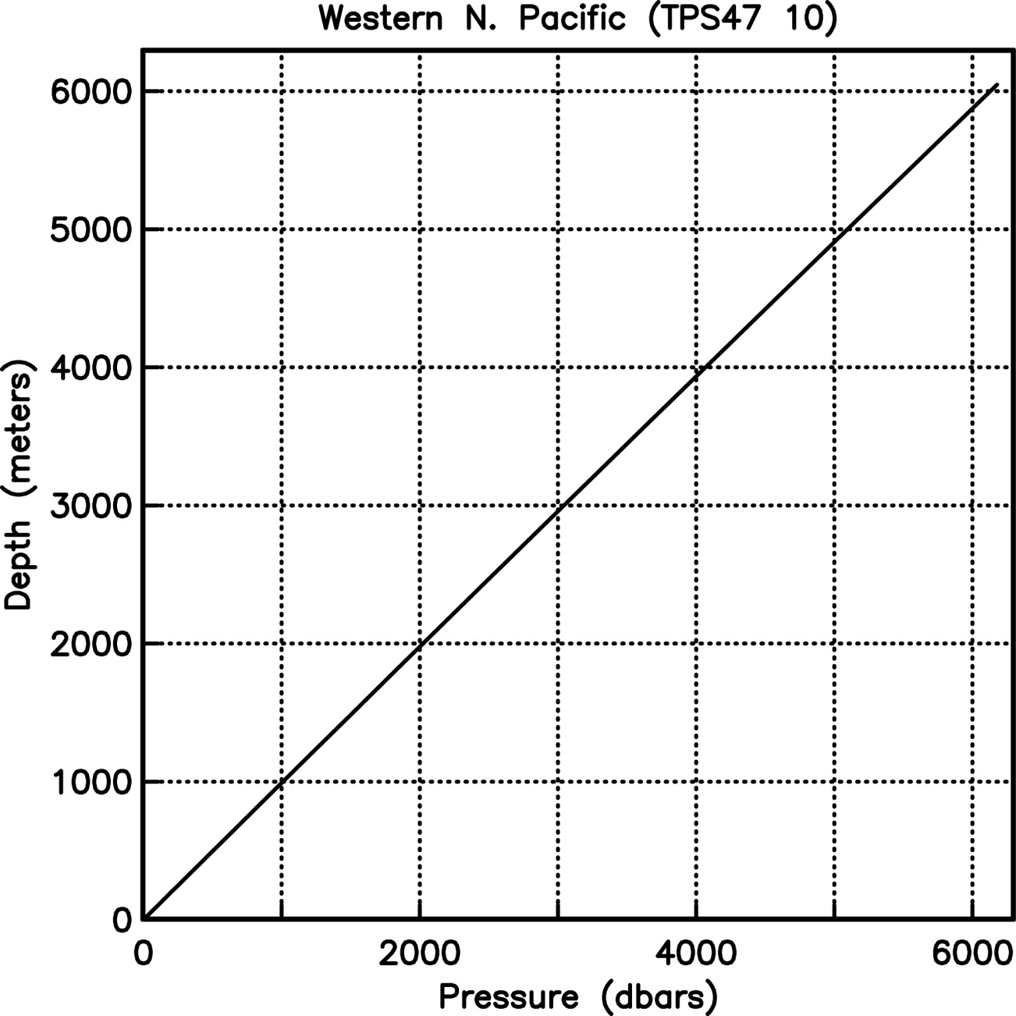
NOWADAYS
Measured as db
100 db =99.55 m
THERE IS AN OFFSET WITH DEPTH

Slide 21
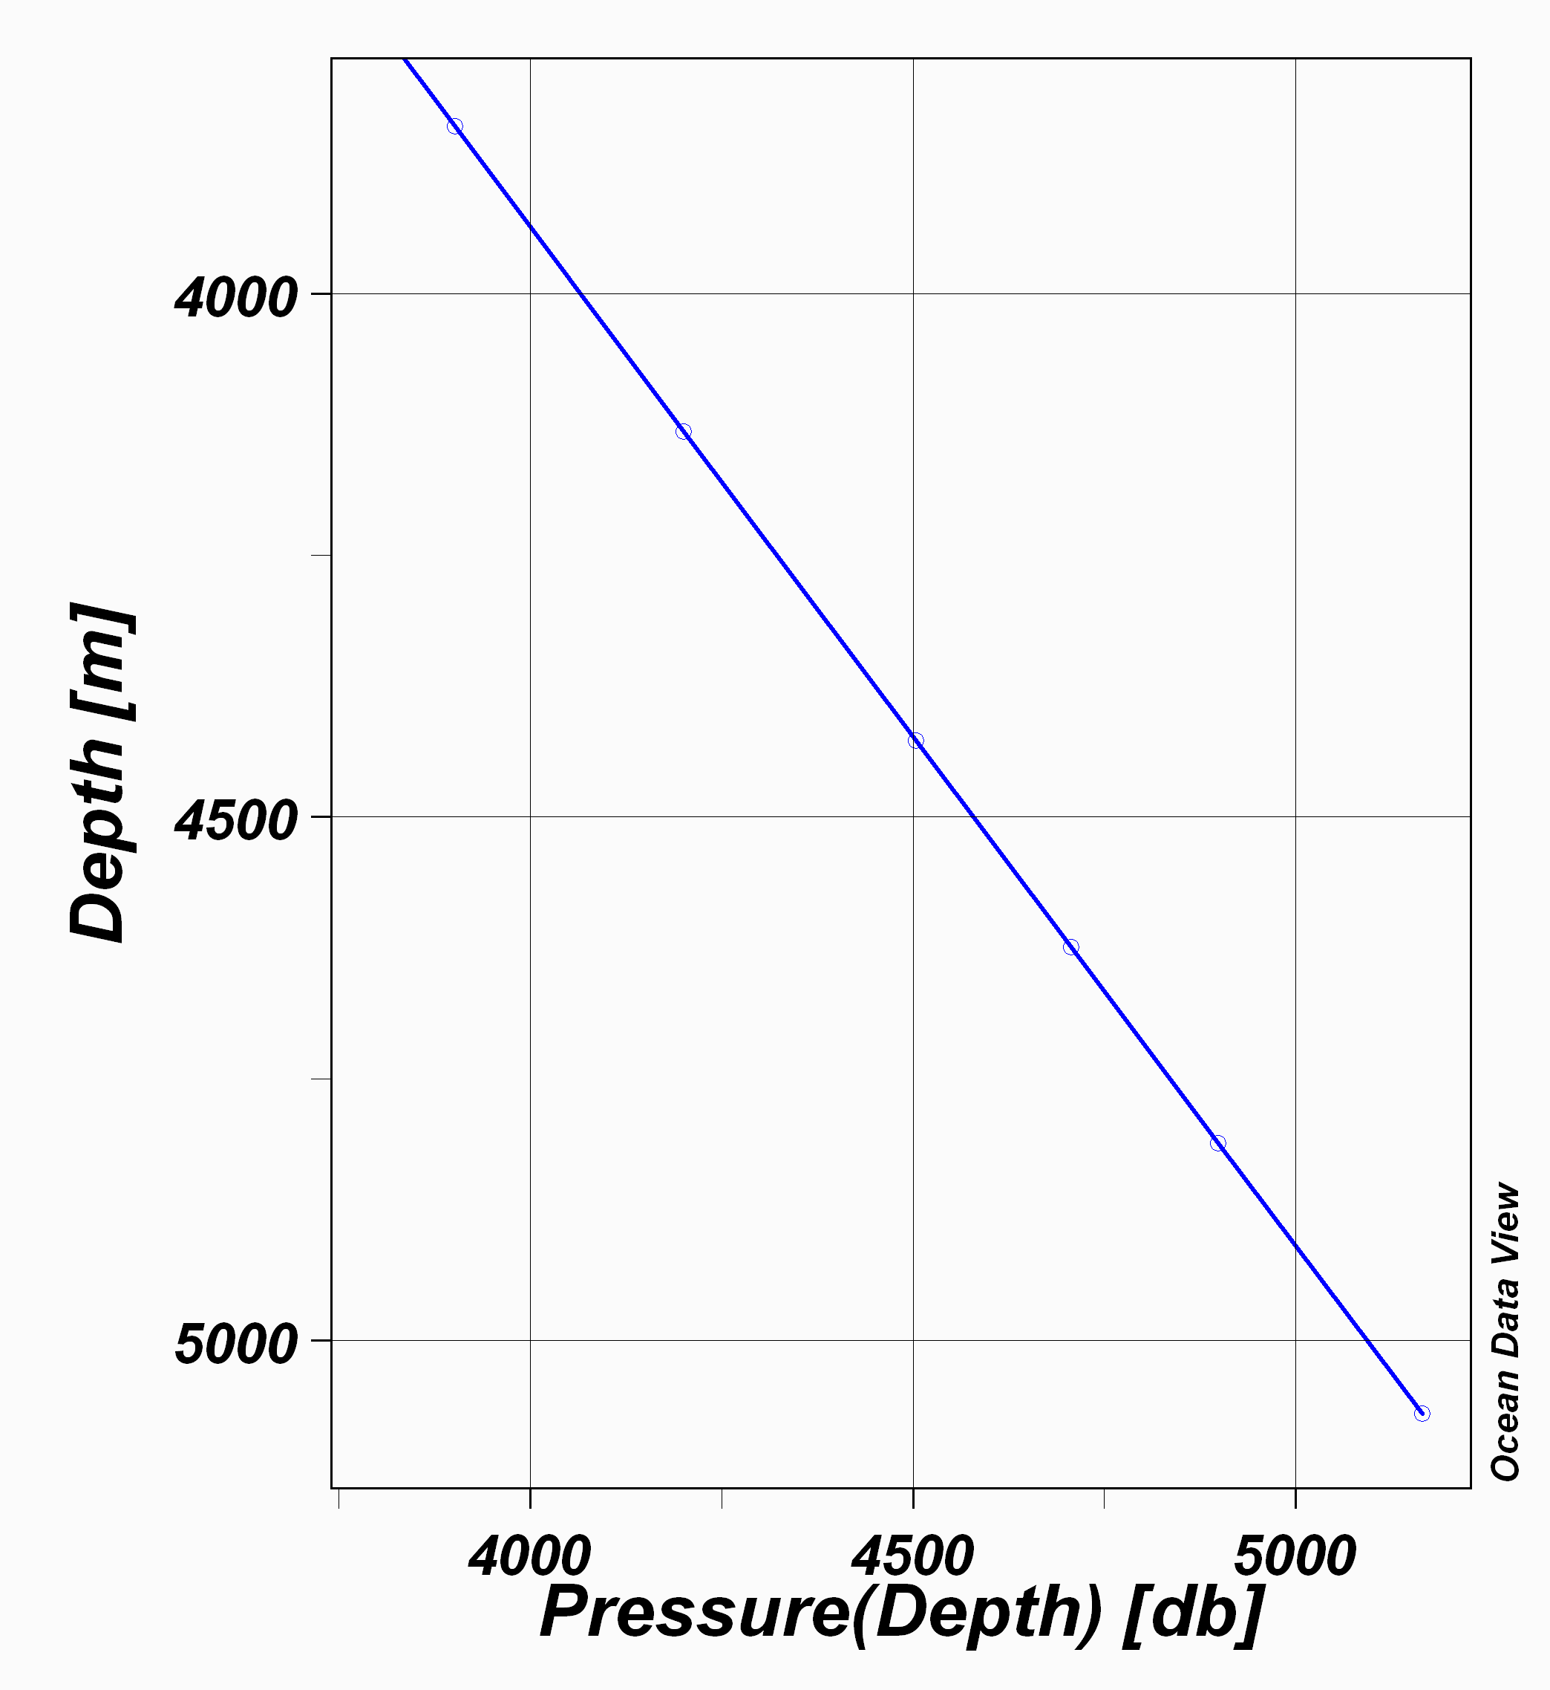
THERE IS AN OFFSET WITH DEPTH

Slide 22
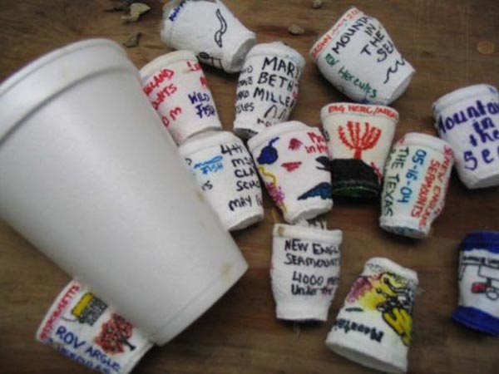
Effects of pressure in the ocean..

